Slide 1

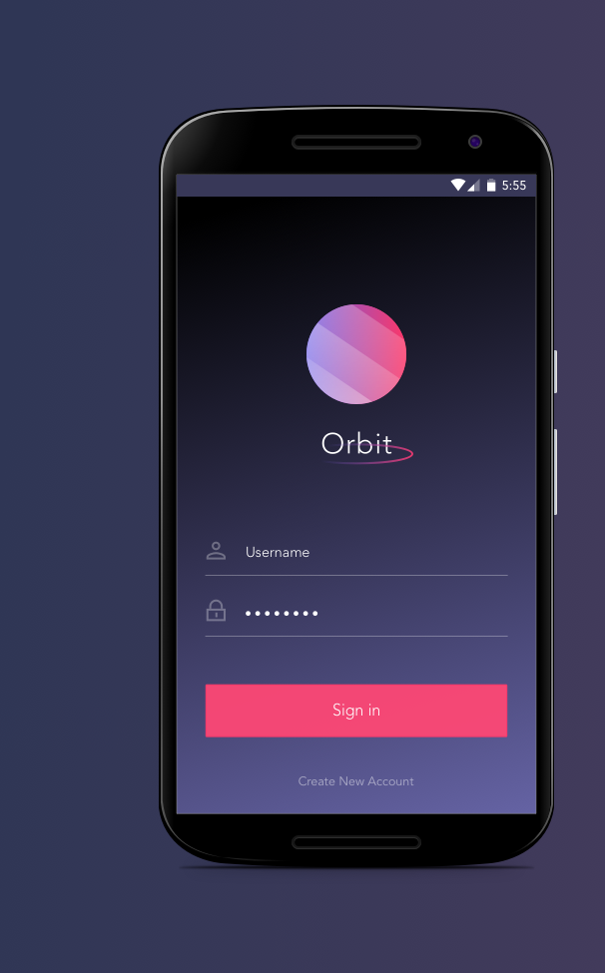
Orbit
Orbit - Percy Teng
WALKTHROUGH
Walkthrough
***screens from design, may differ slightly from current build***
Richard, Carol & Percy

Slide 2
What is Orbit?
Orbit is an application that gathers all personal ads and classifieds in one platform creating a space that is accessible and clutter-free.
Value Proposition
Free App:
Organized: students are able to browse through posts sorted by University, and sorted by category.
Specific: The categories are student specific, ranging from subletting to tutoring to car pooling.
Interactive: Users are able to post ads on items they’re selling or services they’re offering as well as browse through other postings from other students that are selling items or offering services.
Spam-free: Orbit eliminates irrelevant spam and maintains the postings through various ways.
Efficient: This application aims to make search more efficient by offering filtering options (by date, cost - out of scope for MVP)
Browse through sorted categories (i.e. sublets, tutoring, carpool, etc).
Post. Browse. Message sellers.
Simplest way to browse with efficiency.

Slide 3
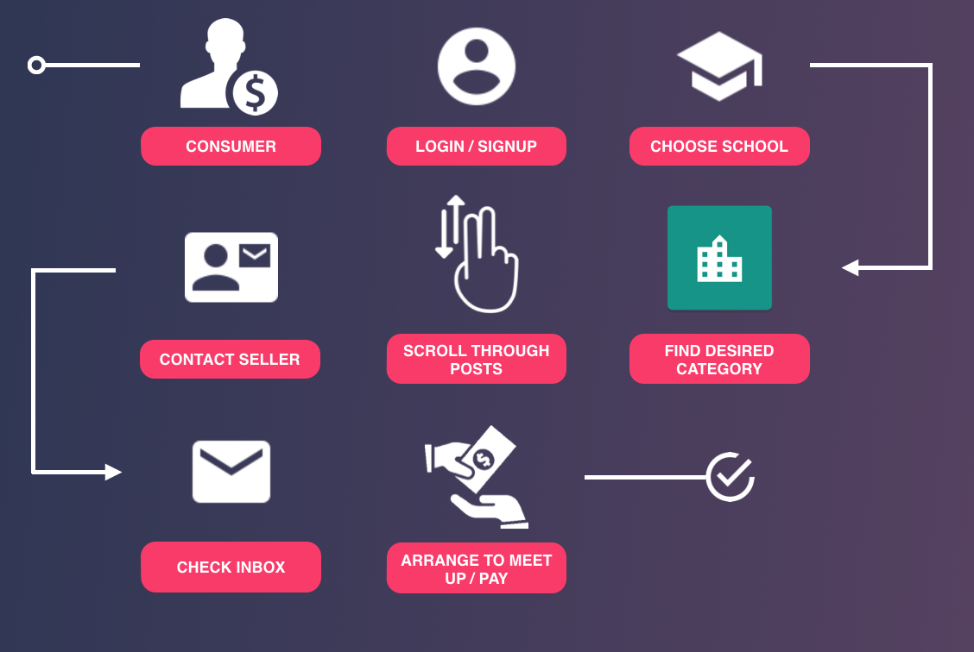
How Orbit works: for the Buyer
Scenario: A University of Waterloo student is looking for a ride back to Markham, Ontario for the weekend.

Slide 4
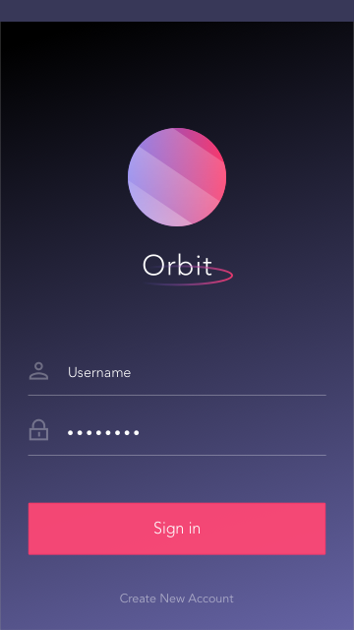
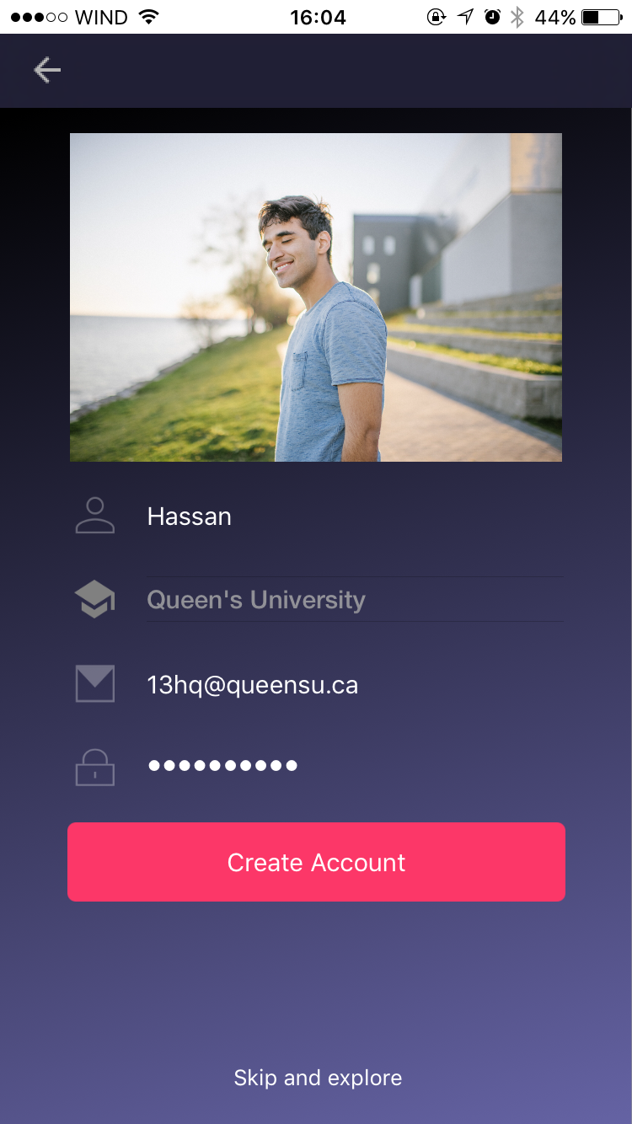
Login Sign-Up Screen
Login Screen
enter username & password and press “sign in”
Create Account
create a new account prompts user to enter a username, e-mail, and password
user can upload a photo for their profile here (optional)
C
B
A

Slide 5
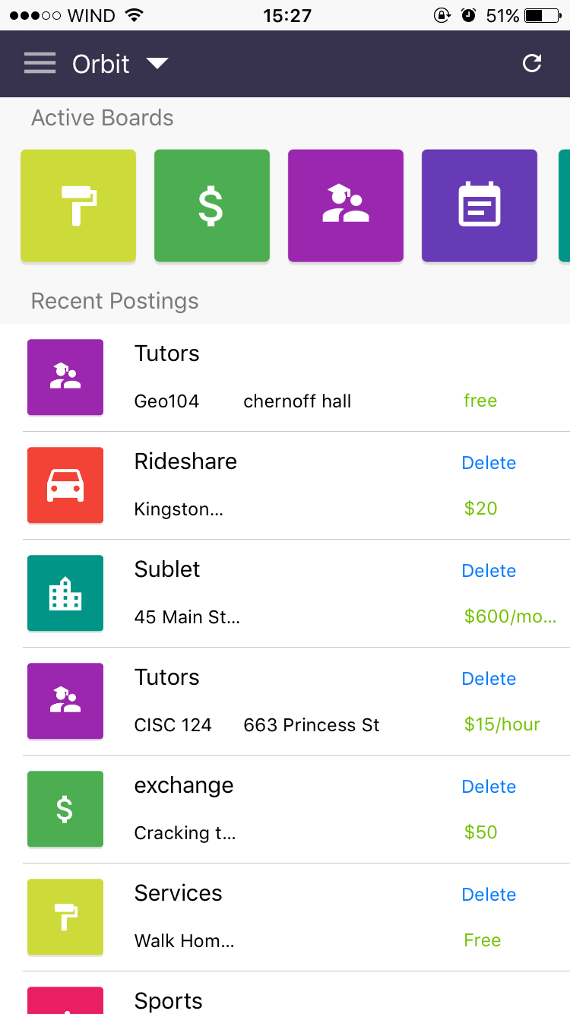
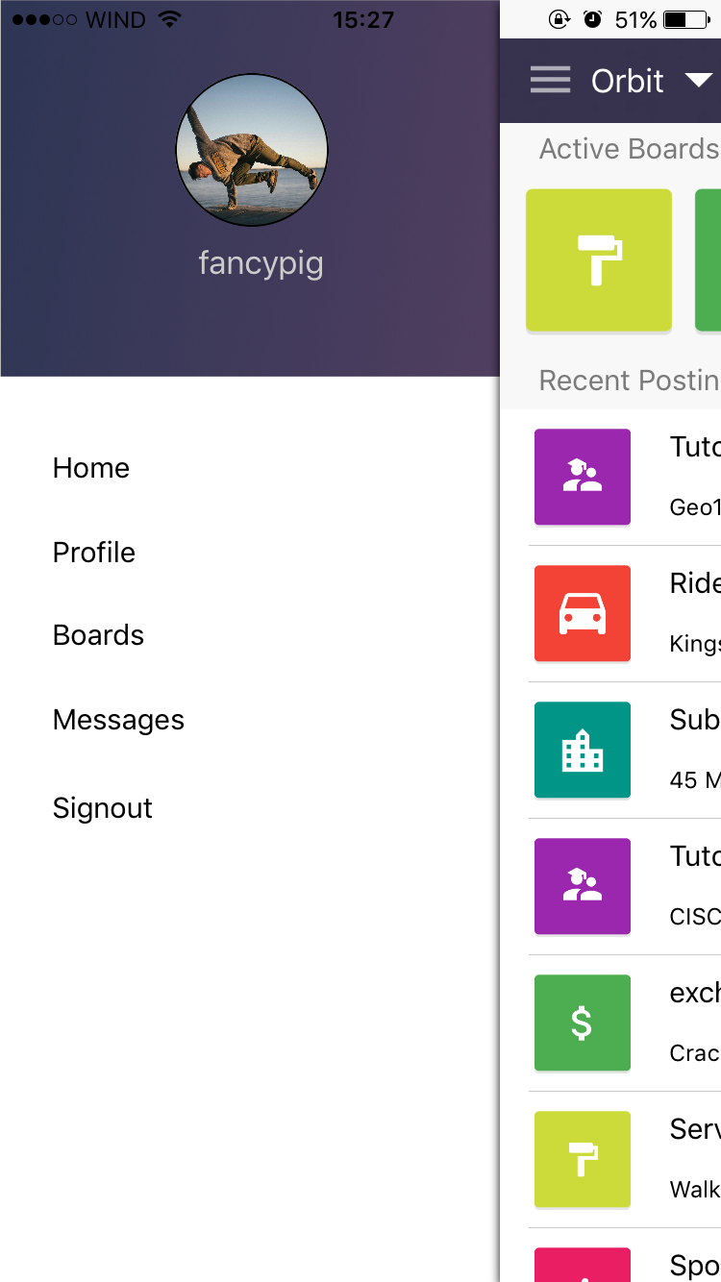
Home Screen & Navigation
D
Home Screen
View the recent postings across all boards (kind of like a news feed of student postings)
Select individual postings to view them in more detail
Select a board to view all postings inside it
Navigation Drawer
Accessible by selecting the hamburger menu on the navigation bar
C
A
B

Slide 6
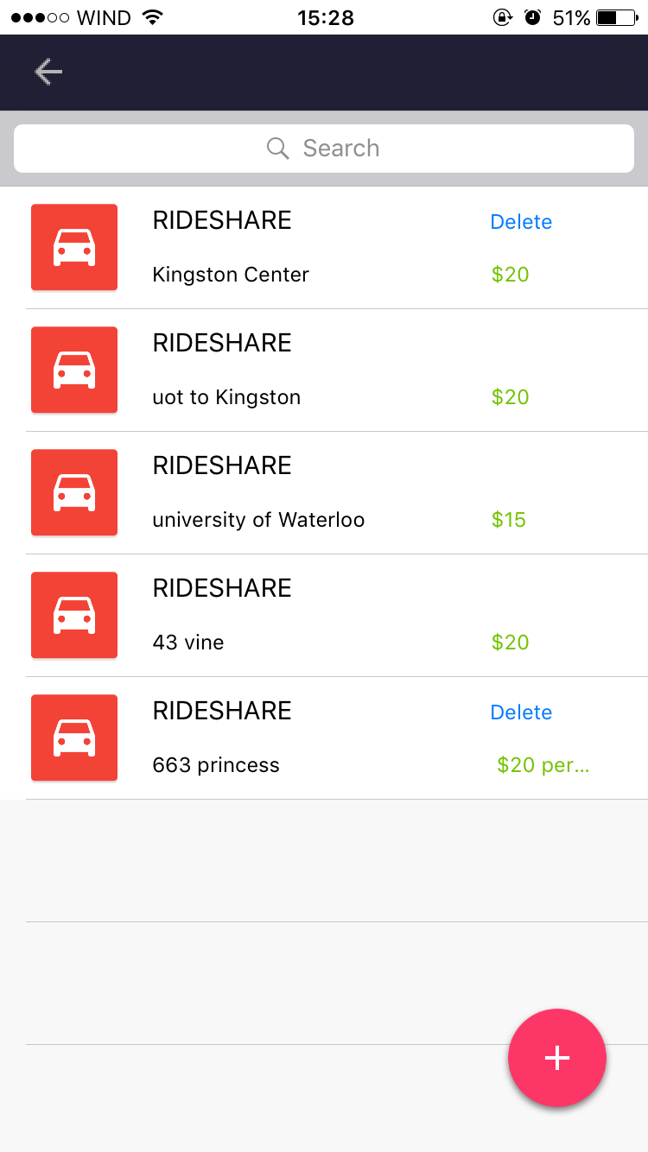
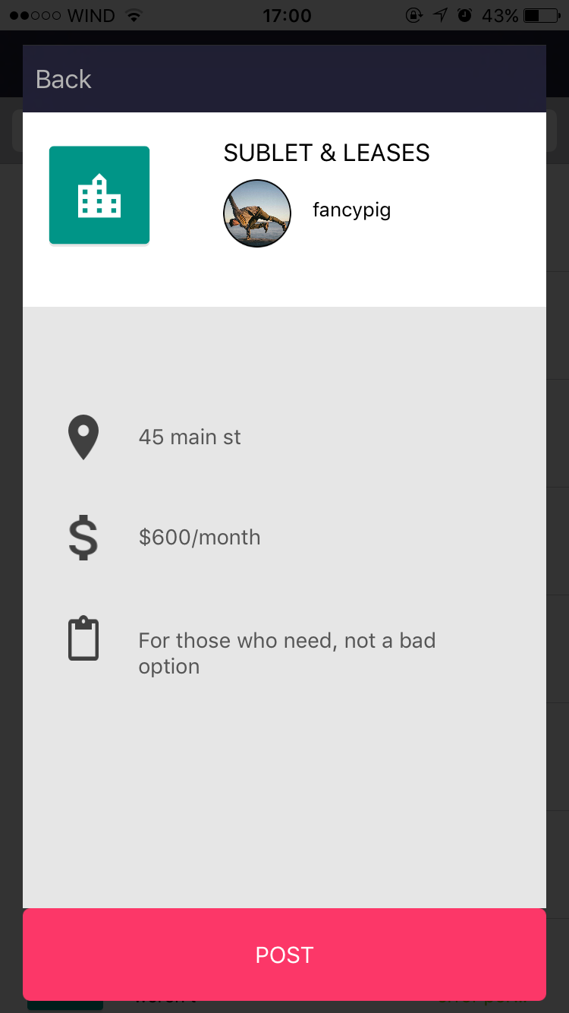
View and create Postings in Board
View Post
Users tap a posting to view more details
Users can only delete the posts they created
Users can search posts with certain keywords
By clicking the fixed button at bottom right, users can create a new post
After entering information, press POST to proceed
C
A
B
E
D

Slide 7
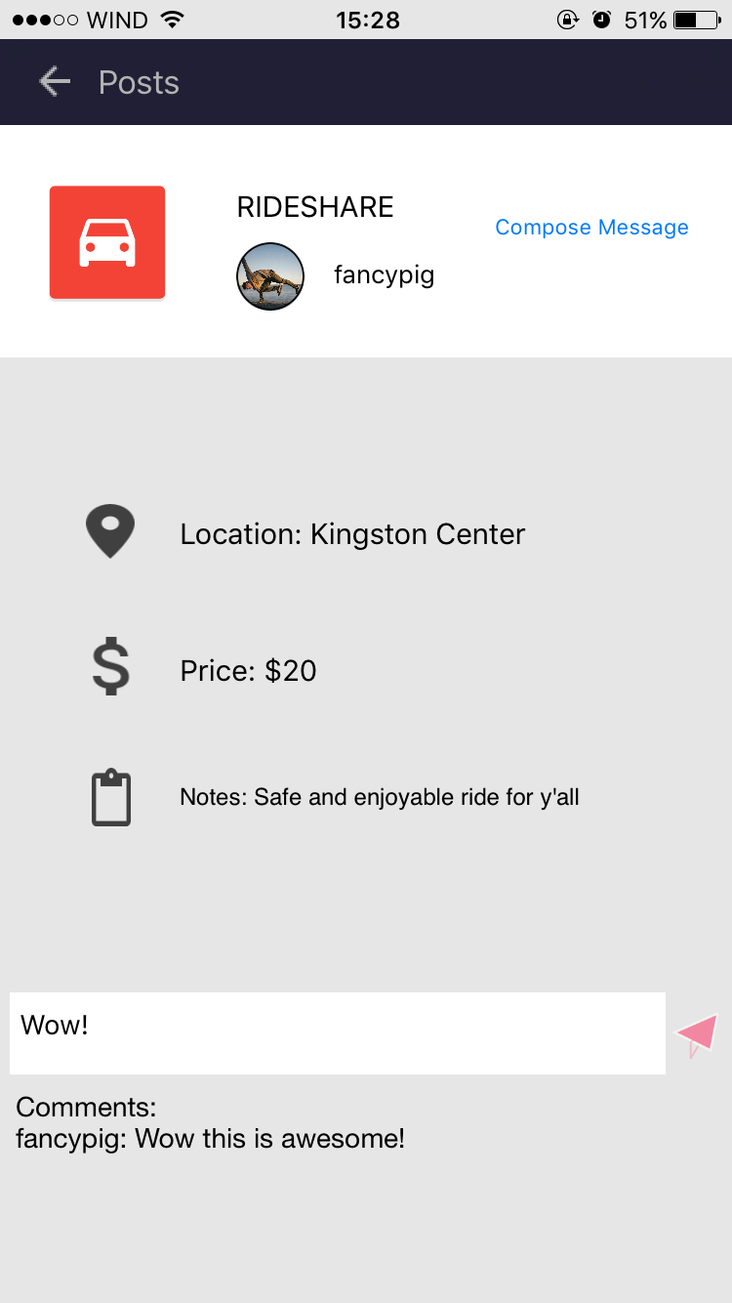
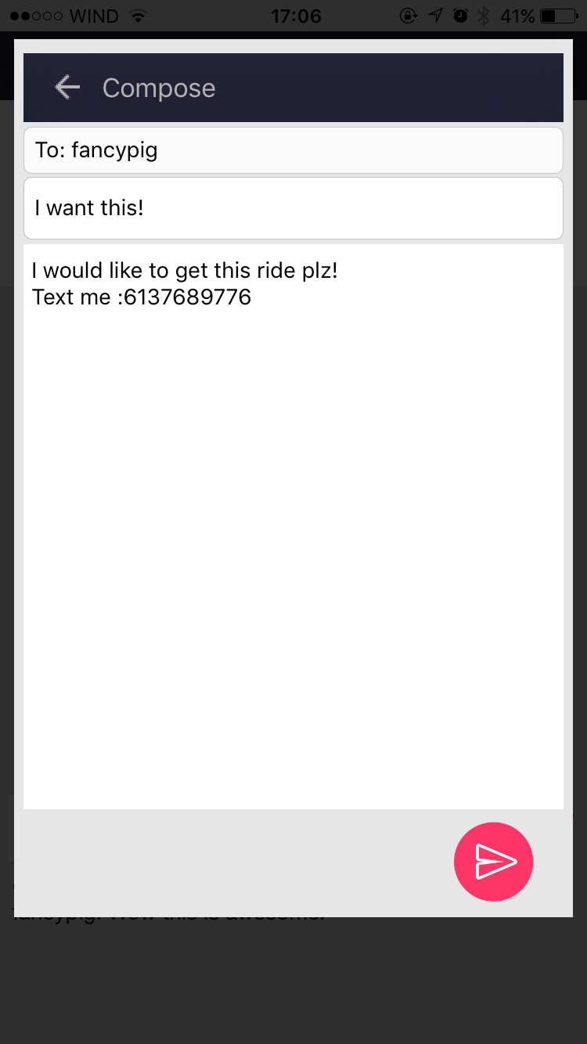
View Posting (Specific)
View user profile by selecting username or avatar
Write comments directly in the posting
Compose a message if users are interested in contacting whoever made this posting
A
C
B

Slide 8
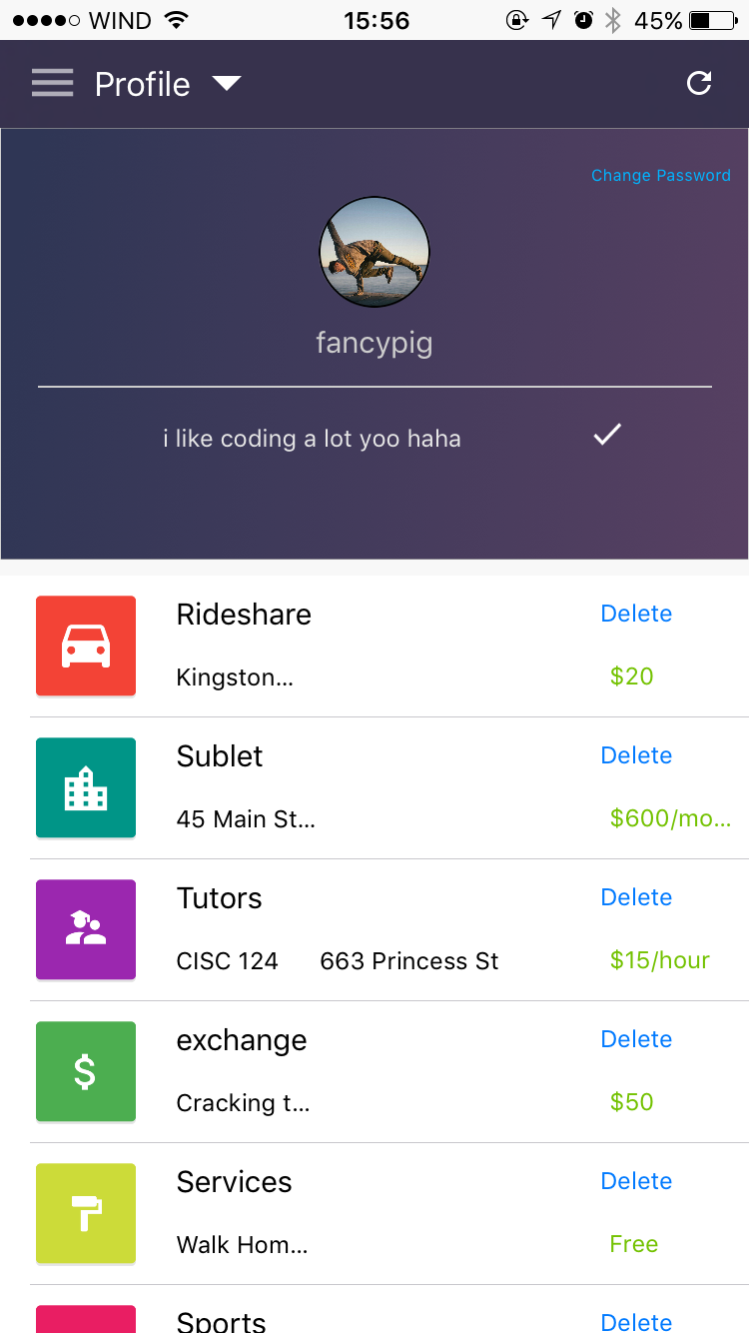
View User Profiles
Press profile on navigation drawer
Change your bio
Manage your own posts
Change your password
D
B
A
C

Slide 9
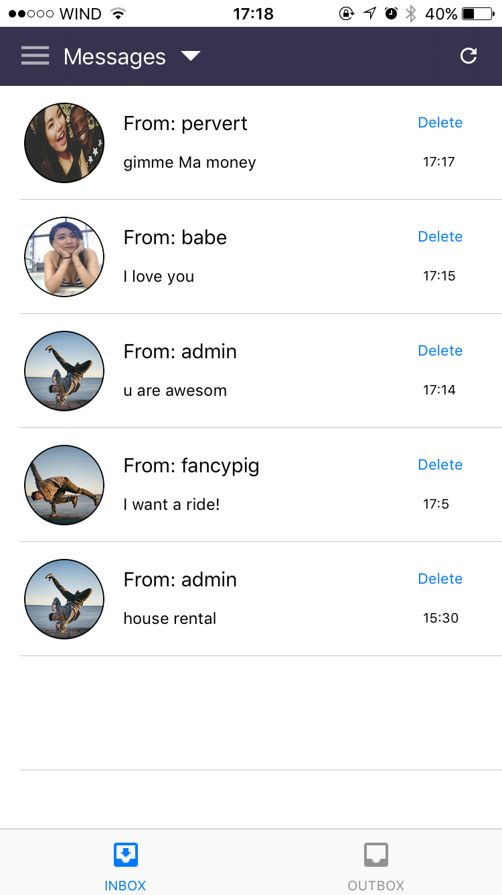
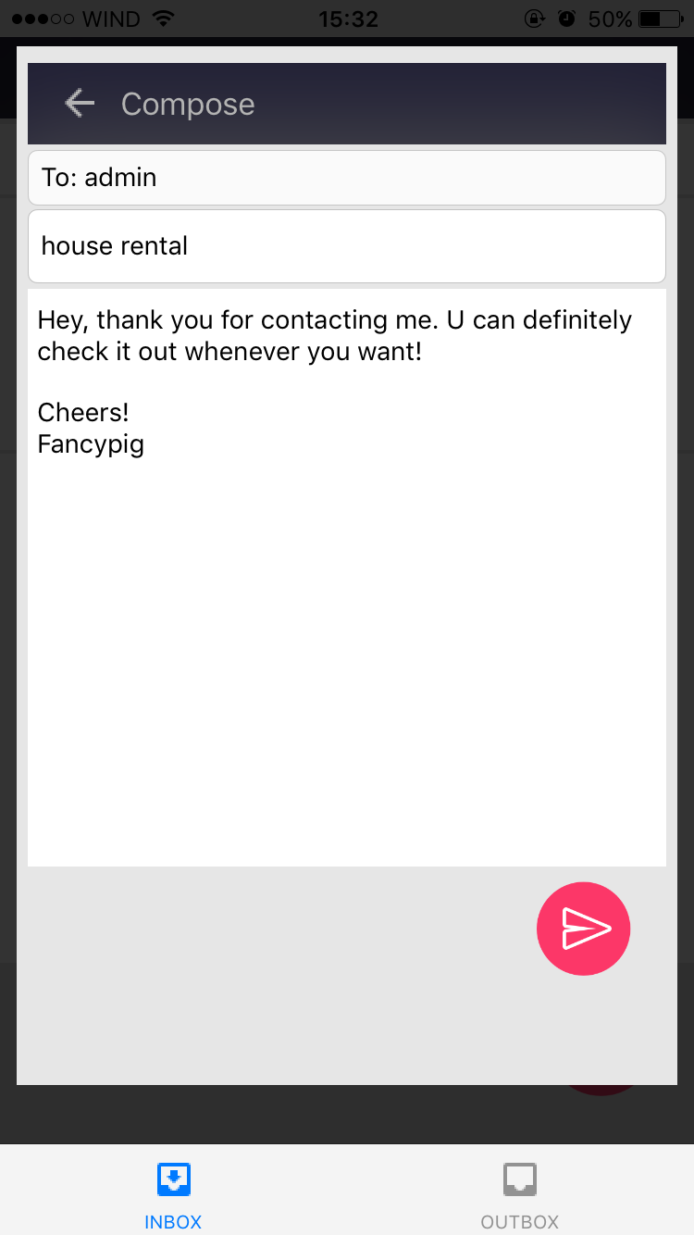
Messages (Inboxes & Outboxes)
View Messages in inbox (received) and outbox (sent)
Messages include header, body text, timestamp, and sender username and profile picture
Reply by clicking the button
A
B
C

